Slide 1
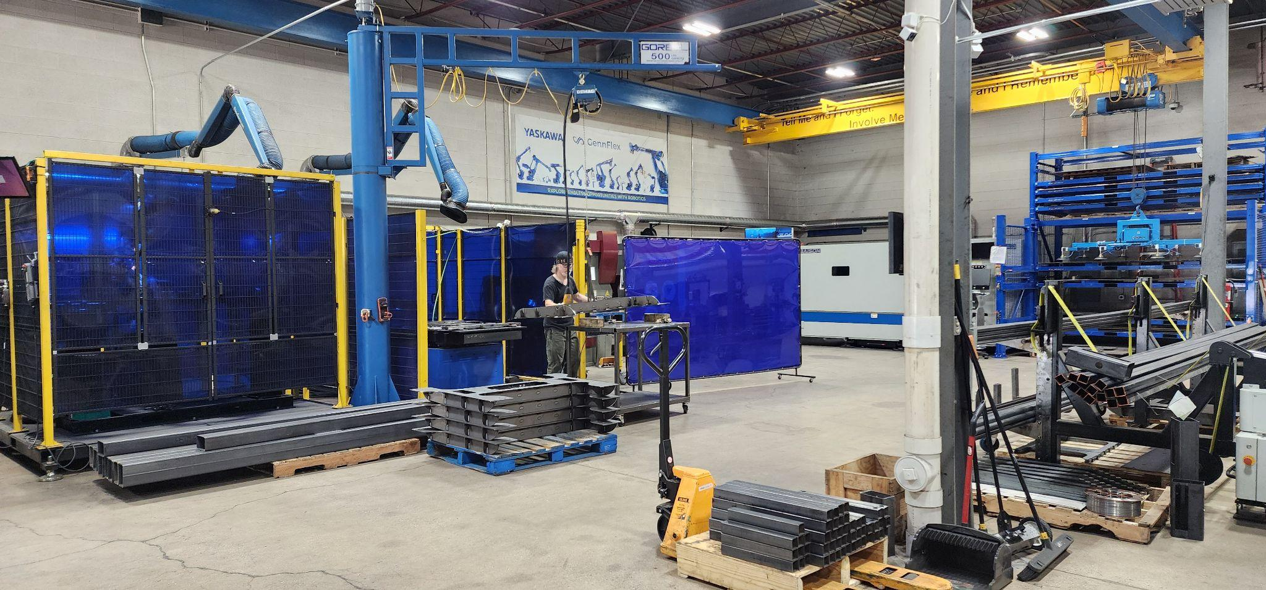
NextGen A.I.R. Academy & Smart Factory
For The State of Ohio
The ICR24/7 Smart Factory in IL -This facility serves as
a proof-of-concept for the NextGen A.I.R. model
Notes:
Opening Script: "Good [morning/afternoon], Lt. Governor Tressel. It’s nice seeing you again! Thank you for for meeting with us today, on behalf of KIp’s recommendation!. We’re excited to introduce you to NextGen A.I.R. - a revolutionary project that's transforming both advanced manufacturing and youth workforce development in Ohio." The GennFlex Smart Factory in Wheeling, Illinois facility serves as a proof-of-concept for the NextGen A.I.R. model - integrating automation, robotics, AI-driven scheduling, and lean production systems in a compact, high-output footprint.

Slide 2
MARKET RESEARCH
Ohio Manufacturing Landscape
Strategic Advantages
Ohio’s $130B+ Manufacturing Sector Needs: - 155,000 skilled workers by 2030 - 5-7% annual sheet metal fabrication growth
Target Population: - 25,000 under-resourced youth in tri-cities - 50-69% unemployment rates - $10k-$13k annual government costs per person
Reshoring Trend: - 16% shift to domestic production - Reduced tariffs and supply chain risks
Notes:
But we have a GUY who has his finger on the pause of business

Slide 3
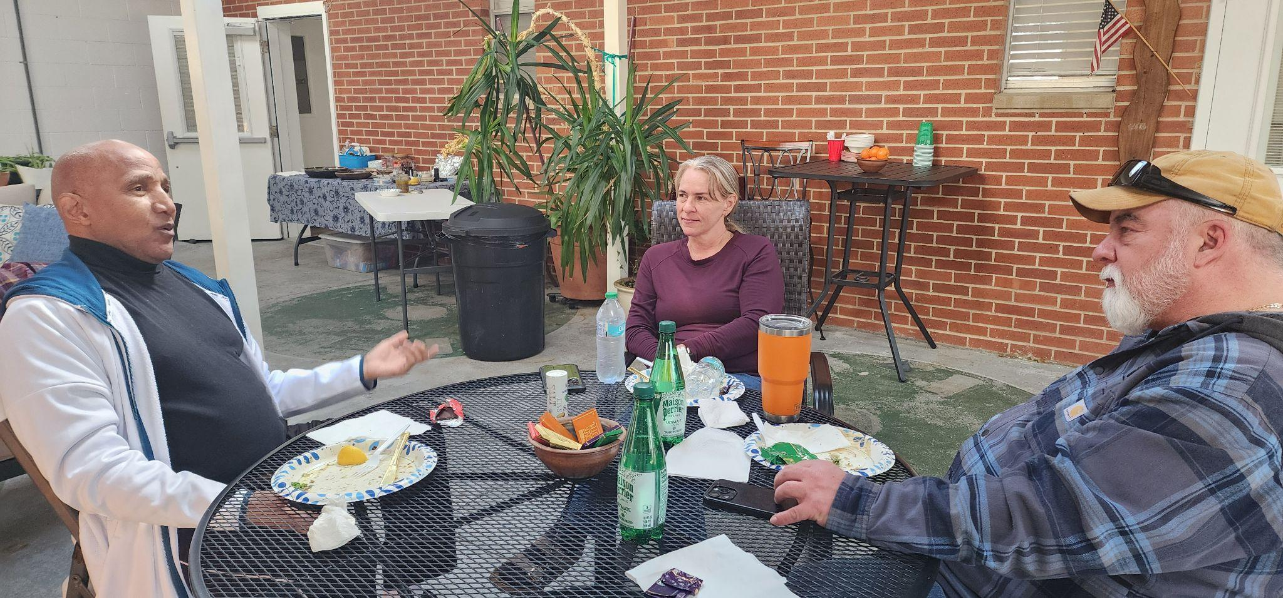
“Oh, That Will Work!” - Kip Morris
Notes:
Transition: "Let me start by Introducing our collaborative Team and sharing our vision and mission..."

Slide 4
NextGen A.I.R.’s Collaborative Presentation Team
Dr. Jerry Farley, VP of Career Technical Education,
Oakmont Education
Clint Chapman, Sr. Manager Strategic Partner Relations For Education/Workforce Development, Yaskawa Motoman
Steven Roe, Sr MA Strategy Business Management Advisor,
CEO NextGen A.I.R. Smart Factory
Jalyn Q. Roe, Strategic Impact-Partner Relations,
Executive Director, NextGen A.I.R. Academy

Slide 5
NextGen A.I.R’s Mission
Our Mission:
Notes:
Mission Discussion (45 seconds): "Our mission brings this vision to life through intensive, high-tech training programs. Every graduate receives guaranteed employment and a debt-free path to the middle class. We're creating foundational blessings that will impact families and communities for generations."
Key Points:
Systemic vulnerability to middle-class security
Positive Social Impact
Debt-free pathway focus
Transition: "This vision is backed by an exceptional leadership team..."

Slide 6
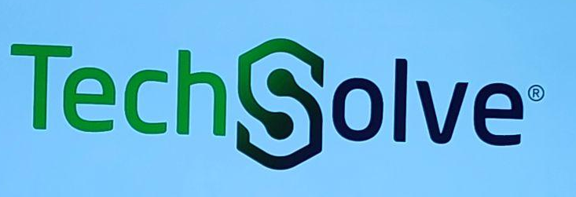
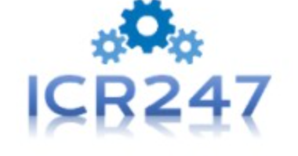

NextGen A.I.R. Advisory Team
Traci Spencer - Director of Government Programs |Former Position Associate Director, Ohio MEP OH Department of Development Strategic Investments Division
Anton Koretskov - Engineer & CEO ICR247
Clint Chapman - Senior Manager Strategic Partner Relations

Slide 7

NextGen A.I.R. Advisory Team
Traci Spencer - Director of Government Programs |
Former Position Associate Director,
Ohio MEP OH Department of Development Strategic Investments Division
The Problem Solver

Slide 8
NextGen A.I.R. Advisory Team
Anton Koretskov - Engineer & CEO ICR247 |NextGen A.I.R. Model “Proof of Concept”
The Visionary

Slide 9
NextGen A.I.R. Advisory Team
Clint Chapman - Senior Manager Strategic Partner Relations
The Catalyst

Slide 10
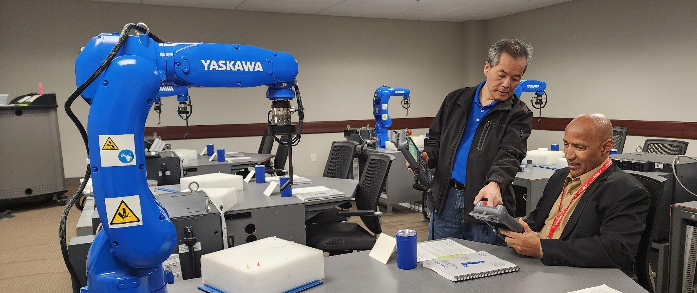
NextGen A.I.R. Academy
“We Will Be Training Tomorrow’s A.I., Robotics, and Automation Workforce Specialists Today!”
Notes:
Workforce Development Projections:
Skilled Labor Pipeline: Strategic collaborations between educational institutions, local industry, and government are developing workforce pipelines for mechatronics, machine maintenance, and smart system integration, critical for metal fabrication factories adopting advanced automation and digital tech.
Job Market Evolution: While some repetitive or lower-skill roles may decrease, higher-value tech and engineering jobs will rise, driving wage growth and attracting younger talent.

Slide 11
I-75 Business Corridor
Industry and Workforce Needs Analysis
Notes:
Next Air Academy & OakMont Education are Collaborating to have our first Smart Factory in OHIO along the I-75 Business Corridor Industry and Workforce Needs Analysis. Conducted in partnership by the award winning Alpaugh Family Economics Center at the University of Cincinnati 2015 - 2035
Next Air Academy & OakMont Education are Collaborating to have our first Smart Factory in OHIO open along the I-75 Business Corridor

Slide 12

Sectors with the Highest Employment Growth
Between 2015 and 2035, the two industry segments with the highest growth between I-675 in Dayton to I-275 in Cincinnati will be:
  Advanced Manufacturing.
  Healthcare
Notes:
Top Industries: Advanced Manufacturing & Healthcare

Slide 13





Industries with High Shift Share
61% require high school diplomas with these Top Five Essential Skills
Critical Thinking
Active Listening
Speaking
Reading
Comprehension
Monitoring
Observe | Assess | Track Performance | Progress Over Time To Identify Areas For Improvement, Take Corrective Action, and Ensure Goals Are Met | Assessment, Observation, Feedback & Analysis, Adaptation
Notes:
61% of these top 2 industries require ONLY a high school diplomas with these Top Five Essential Skills — NextGen AIR Academy Teaches this next generation how to think!
Observe | Assess | Track Performance | Progress Over Time To Identify Areas For Improvement, Take Corrective Action, and Ensure Goals Are Met | Assessment, Observation, Feedback & Analysis, Adaptation

Slide 14
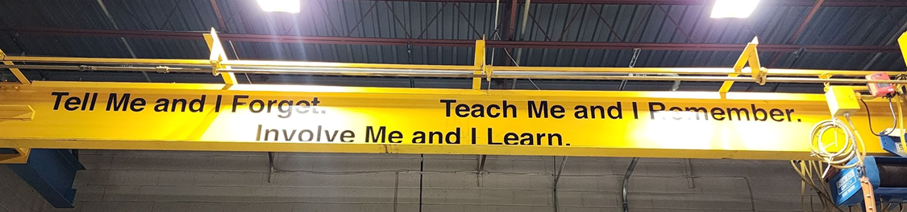
NextGen A.I.R. Smart Factory Initiative
“Revolutionizing Manufacturing Through Youth Empowerment”
Ohio Workforce Pathways
Three Strategic Ohio Locations: Dayton, Cincinnati, Columbus
Industry 4.0 Advanced Manufacturing
Transformative Social Impact Investment Opportunity
Notes:
Key Points to Emphasize:
NextGen A.I.R. represents the future of manufacturing
We're creating pathways from vulnerability to job-security
Three strategic Ohio locations with Industry 4.0 technology
2) NAIR Smart Factory, STATS/economy, MOU, 3 OH Smart Factories near Oakmont Education in Dayton/Cinci/Akron. NAIR-Employer/employee linkage. Profitability SF. Potential strategic partners -SDR

Slide 15
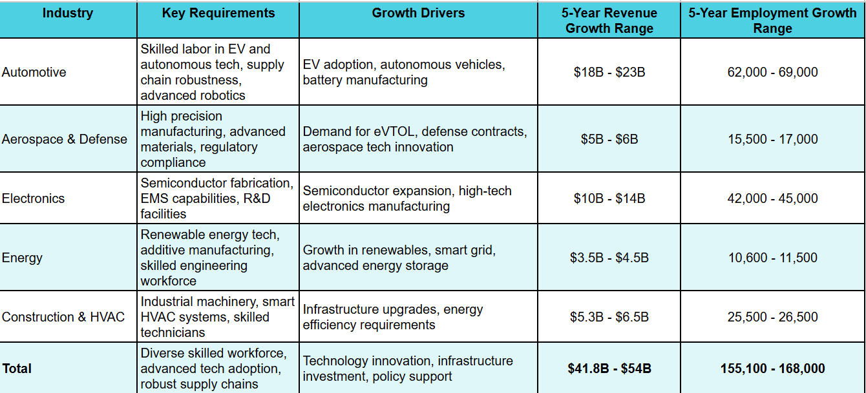
Ohio’s Advanced Manufacturing Market Revenue & Job Growth Potential (in 5yrs)
The Opportunity
Notes:
Summary
Ohio's advanced manufacturing market shows strong growth potential with an estimated $41.8 billion to $54 billion revenue increase over the next five years.
Employment in these sectors is projected to grow by approximately 155,000 to 168,000 jobs, reflecting solid workforce expansion.
Key industries reflect robust demand driven by electric vehicles and battery tech, aerospace innovation, semiconductor growth, renewables, and industrial machinery.
The total projections integrate multi-industry strengths, backed by Ohio’s infrastructure, skilled talent, and innovation investments.
This table and summary provide a clear snapshot of Ohio's advanced manufacturing market potential by industry, highlighting economic opportunity and workforce growth through 2030. The estimates are based on available regional data combined with sector trends and economic development insights.
https://redicincinnati.com/advanced-manufacturing-builds-a-strong-future-for-cincinnati/
https://ohiolmi.com/_docs/PROJ/JobsOhio/Industry_Snapshots/AdvancedMfg.pdf
https://www.expansionsolutionsmagazine.com/lets-grow-together-building-a-stronger-future-in-ohio/

Slide 16
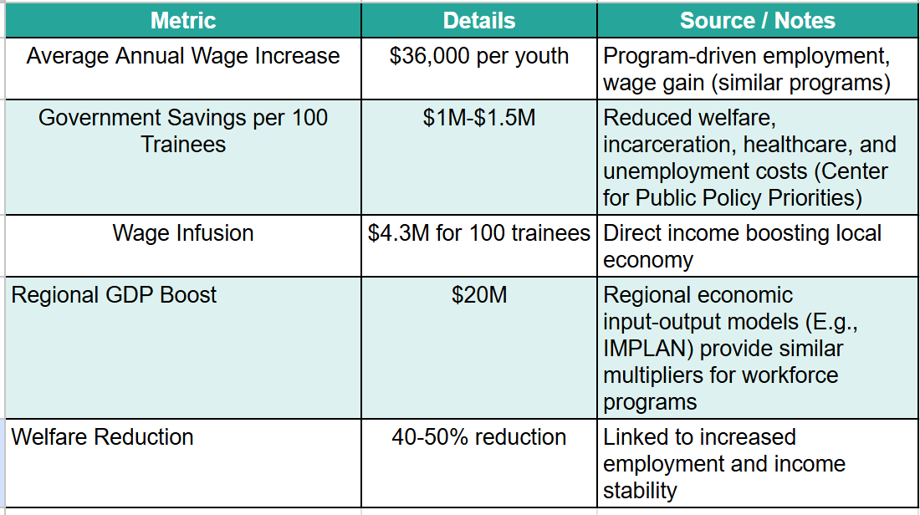
Win|Win For The State & Youth

Slide 17
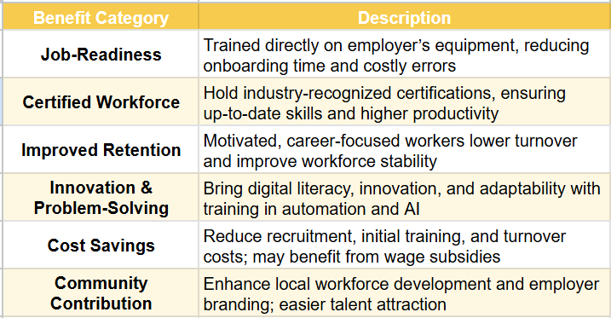
Employer Benefits
Notes:
The following table captures the key benefits for small and mid-sized manufacturers hiring youth trained at advanced manufacturing facilities.
Reduced onboarding costs
Reduced training costs by hiring a highly trained, job ready candidate

Slide 18
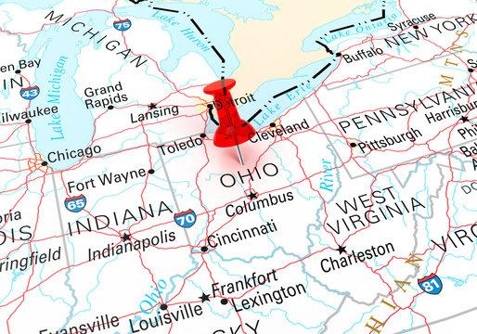
I-75 Business Corridor Industry and Workforce Needs Analysis 2015 - 2035
Serves as a critical tool in understanding
  Evolving economic landscape
  Workforce demands with soft skills being the most important skills
  Opportunities for growth, development, and industry collaboration for more specific skillsets

Slide 19
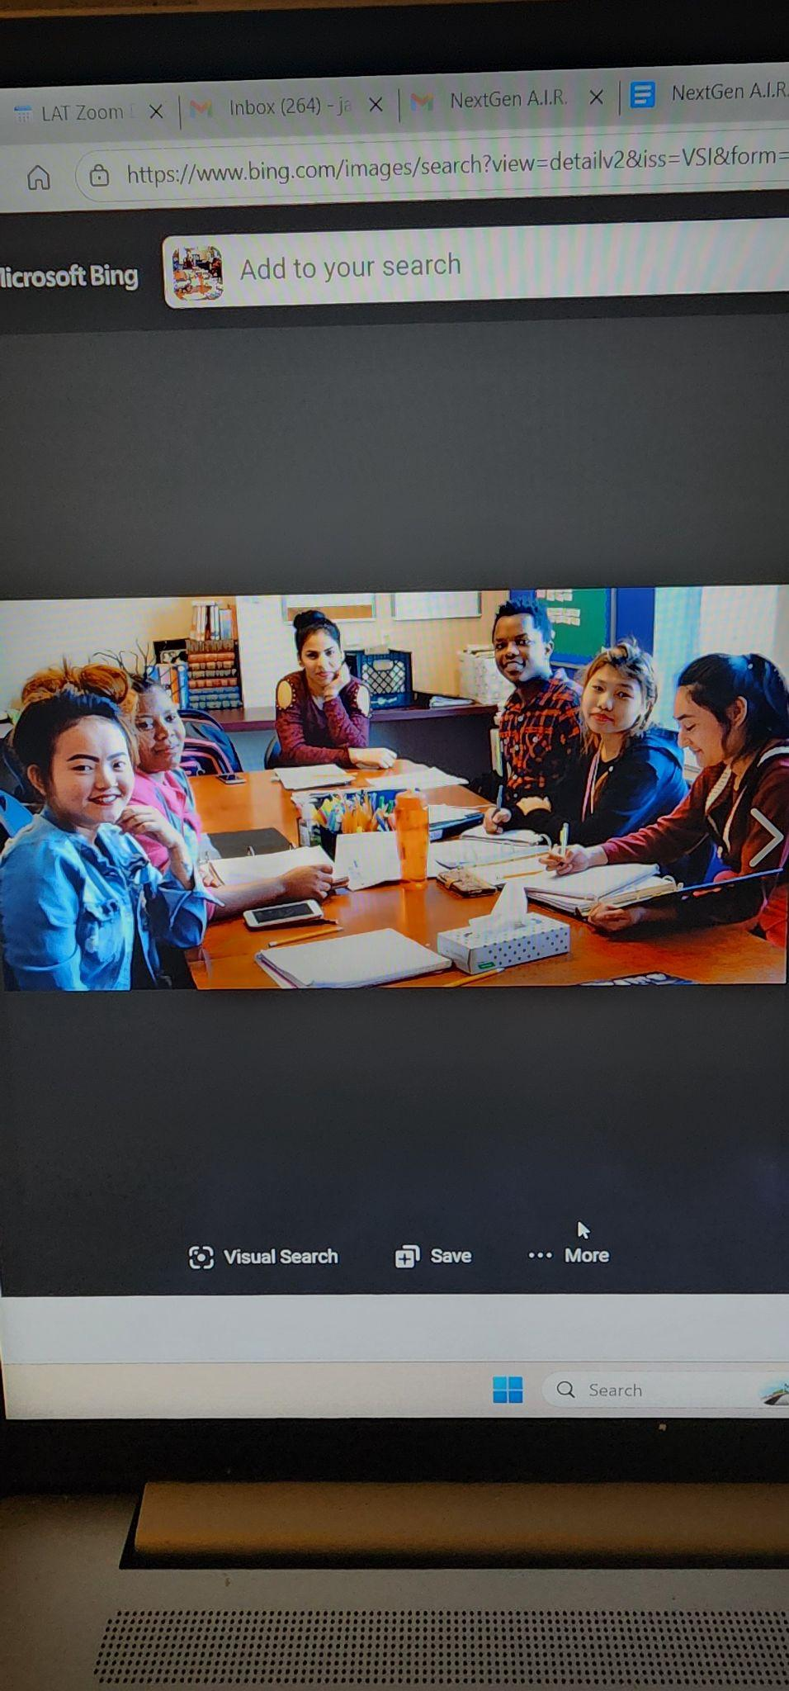
NextGen A.I.R. & Oakmont Education
Impact-Partners
Why This Is A Good Fit:

Slide 20
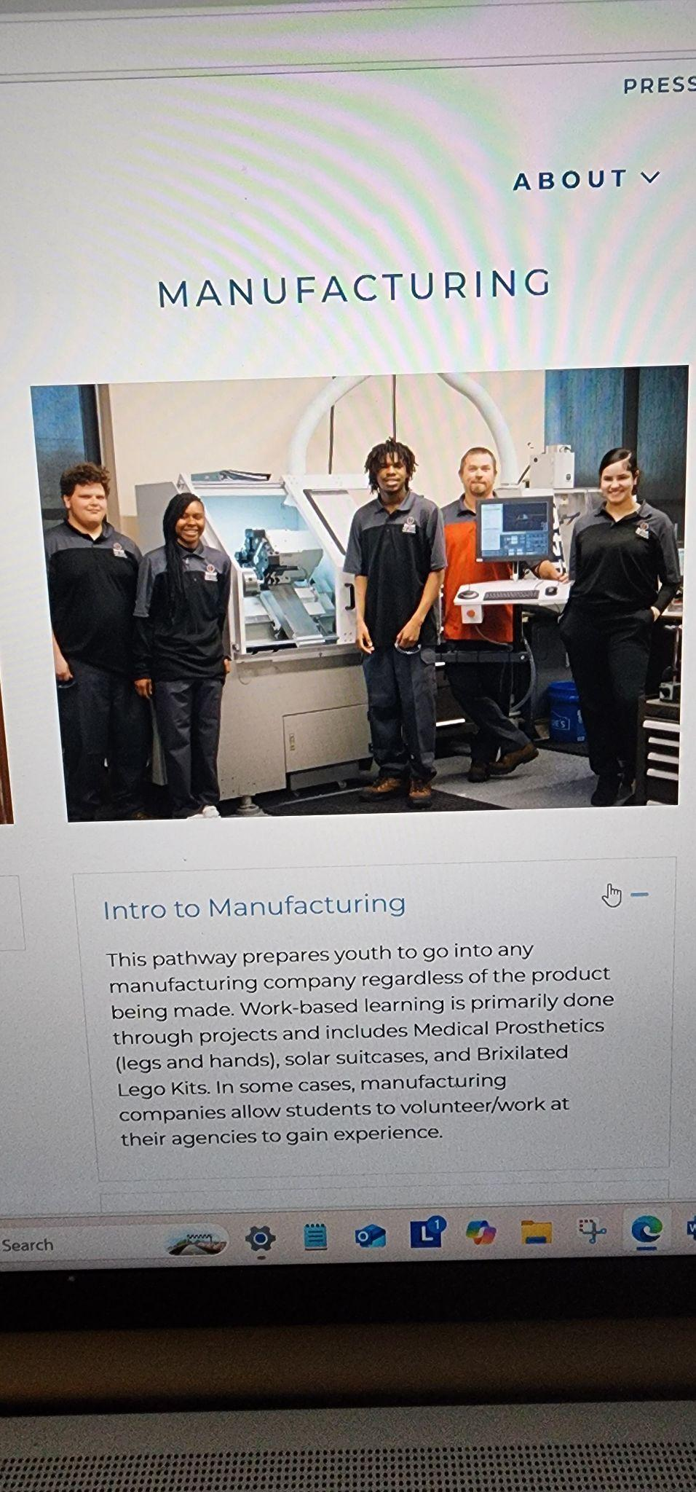
NextGen A.I.R. & Oakmont Education
Impact-Partners
The Rollout -
Phase One:
The Dayton Location
Notes:
JERRY / MOU / Why together we will have an impact

Slide 21

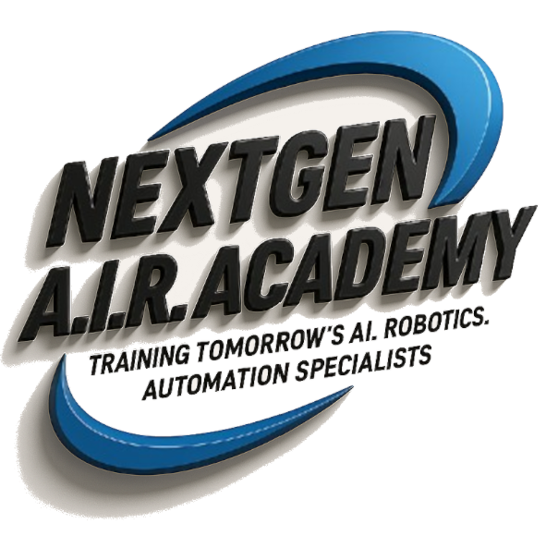
Individualized Education and
Career-Focused Learning
The collaboration between NextGen AIR and Oakmont Education will use a hands-on approach to teaching the next generation of advanced manufacturing skilled workers to be job-ready from day one.
It will be a powerful model of innovative and immersive training in AI, automation, and robotics that prepares each student to be an productive member of a smart manufacturing team.
Our students will benefit!

Slide 22
🎓 Benefits for our Students
🚀 Oakmont’s Workforce-Ready Tech Training
Industry Recognized Skills: Students gain craft skills necessary for entry level employment with emphasis on proficiency over credentials.
Work-Based Learning: Logged work hours in the sector build real world experiences that prepares youth to meet employer expectations.
Professional / Durable Skills: Training incorporates aspects of resiliency with additional focus on skills for communication, initiative and professionalism.
Direct-to-Work Pipeline: Career Navigators provide placement assistance AND supports for 12 months to improve retention and employer satisfaction.

Slide 23
Individualized Education and
Career-Focused Learning
The NextGen AIR (NAIR) and Oakmont Education (OE) Collaboration will be centered around OE’s four pillars philosophy of Heal, Hope, Workforce Development and Post-Secondary Placement, coupled with NAIR’s belief that technology can transform an individual’s life, a community and a country.
Employers Will Benefit!

Slide 24
🏭 Benefits for Employers
🤝 Employer Benefits of Oakmont’s Workforce Model
Workforce-Ready Talent: Reduces onboarding time and cost:
  Using a Sector Strategy Approach, employers have direct influence on the skills taught so that CTE graduates meet employer expectations.
  Work-Based Learning enables employers to vet students at no cost and establishes relationships securing a talent pipeline.
Innovation Advantage: AI- and robotics-train students for emerging workforce demands as the manufacturing sector evolves.
Addresses Labor Shortages: Employers systemically address worker shortage issues, enabling growth for Ohio’s manufacturing sector.
Notes:
REMEMBER: By 2030 Ohio is going to need 30 Thousand new skilled people!

Slide 25
The Concern
Significant Labor Shortages in the Manufacturing Sector:
  Aging Workforce
  Fewer young people entering the workforce
  The demand for workers will continue to outpace the number of people available to work
  According to CNBC’s America’s Top States for Business 2025, Ohio ranks 31st in workforce / labor supply.
  Research by Deloitte found that many manufacturer’s report unfilled jobs as a key constraint on production capacity.

Slide 26
A Potential Solution
Unemployed Youth = Lost Potential:
  According to U.S. Census Data, Ohio has over 62,000 unemployed 20-24 year olds.
  The ability to re-engage these youth back into education (if they are high school dropouts) to finish their secondary education with skills training and placement assistance / support could significantly impact Ohio’s Workforce.
  This partnership of Next Gen A.I. R. and Oakmont Education is positioned to address the:
    The Labor Shortage in Manufacturing
    Meet evolving needs of smart manufacturing
    Re-Engage thousands of youth, breaking generational poverty

Slide 27
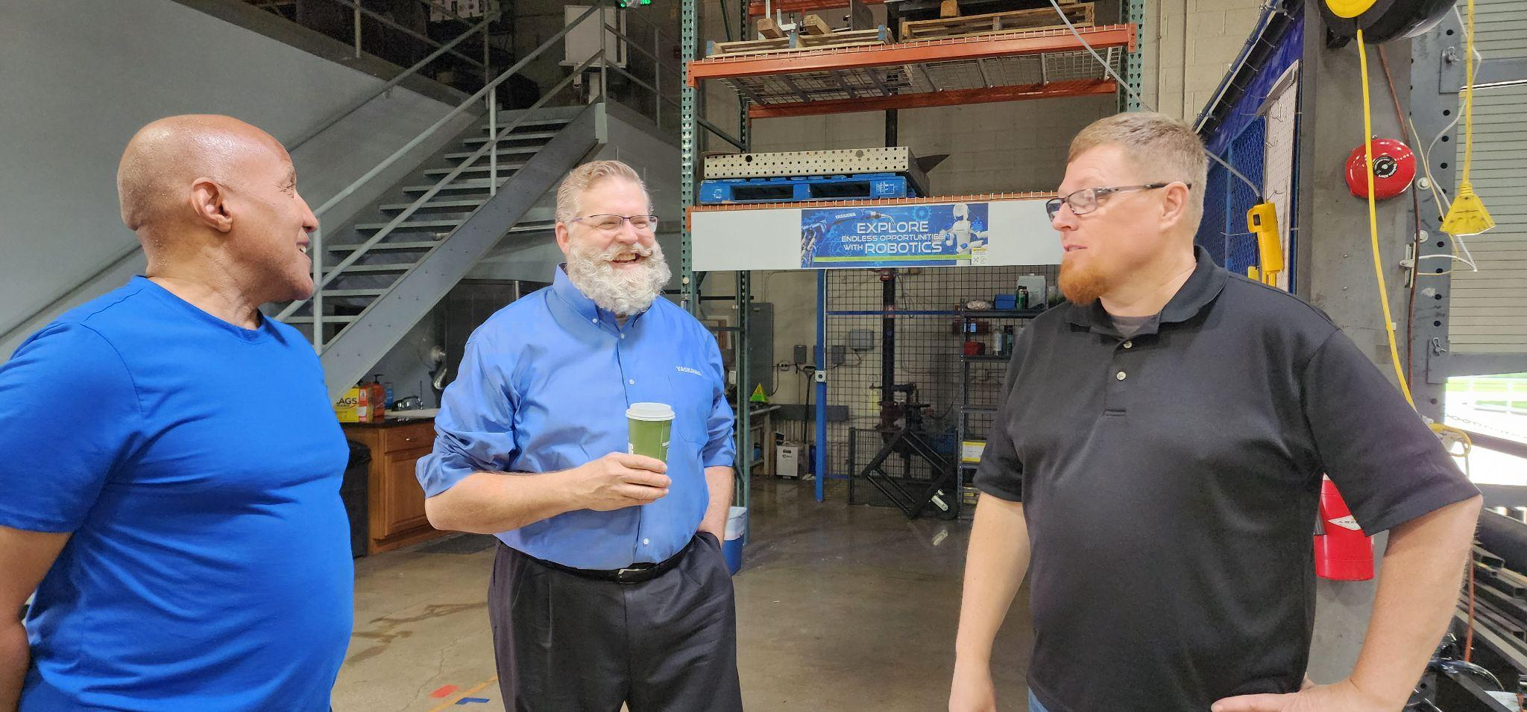
Yaskawa Motoman
Clint Chapman
Strong advocate for workforce development
and robotics education

Slide 28
What I Know For Sure…
As an advocate for workforce development and robotics education-
Why I have been working with NextGen A.I.R. from day one, and a member of their Advisory Team –

Slide 29
The Niches NextGen A.I.R. Will Fill:
Certification Programs: Theory vs Training on actual Equipment in a smart factory.
Aging Out of Foster Care: 45% become homeless.
The Lottery System: Kids that have been aspiring to be in the AI, Robotics, Automation Industries, but their “number didn’t come up!” and their enthusiasm is now stifled.
Marginalized youth who don’t have the opportunity to even see a path forward.

Slide 30
THOUGHTS?
SR Closing
Notes:
sO GIVE US YOUR THOUGHTS? // KIP THOUGHTS // QUESTIONS?

Slide 32
The AsK & Handout
Notes:
Search Assist
Lt. Governor Jim Tressel is leading Ohio's Workforce Playbook initiative, which aims to align education with the state's job market needs by enhancing career pathways and work-based learning opportunities for students. His efforts focus on retaining talent in Ohio and ensuring that educational institutions prepare students for in-demand careers through partnerships with local businesses and community organizations.

Slide 33
Confidentially Speaking

Slide 34



